Slide 1
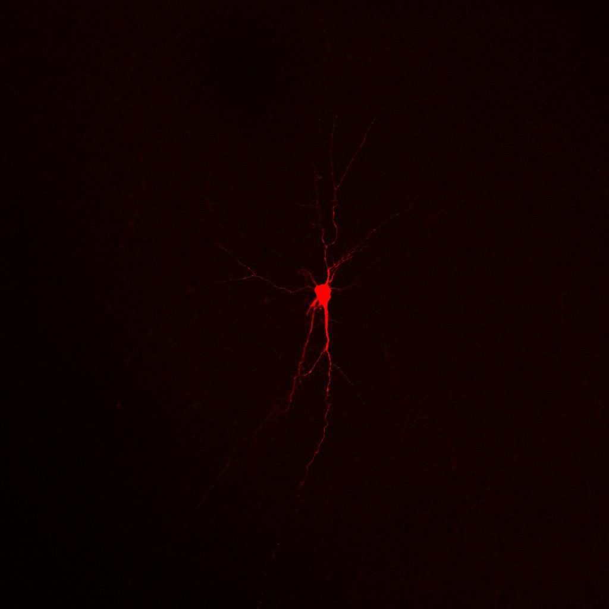
Developmental Biology Meeting
Pax6 and Cortical Cell Specification
Acknowledgments
Dr Michael Daw
Prof. Dave Price
Dr Martine Manuel
Dr Melanie Stefan
Dr Soham Mitra
Dr Sean McKay
Mike Molinek
Dr Adam Jackson
Laura Oliveira
Rita Loureiro
Sarah Tennant
Jonny Marshall
Zrinko
Kai
19 January 2018
Tiago
Centre for Discovery Brain Sciences – Daw/Price Lab

Slide 2
Layering of The Presentation
1. Cortical Progenitors and Pax6
2. Glutamatergic – GABAergic Circuits
3. Cre_Recombinase-LoxP Manipulation
4. Biophysics and Electrophysiology
5 A. Data Stream 1: Ectopic Cell Population
5 B. Data Stream 2: Pyramidal Cells of the Somatosensory Cortex
6. Multiform Plan – Cell culture

Slide 3
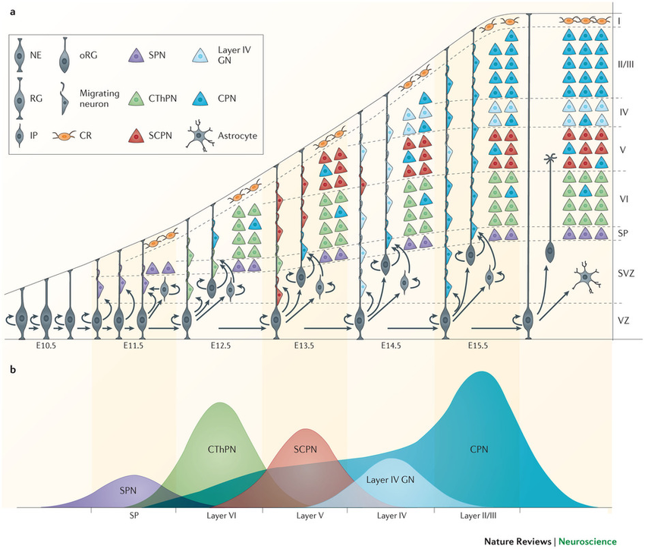
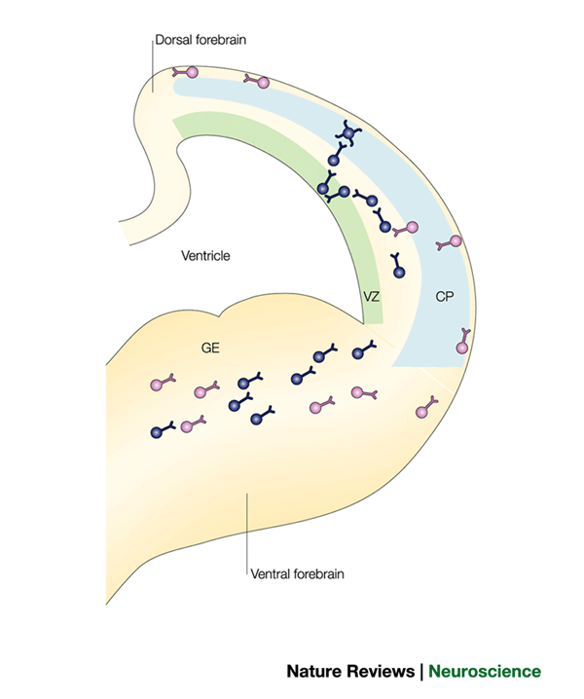
Principal Cells and Interneurons
Principal Cells
Interneurons

Slide 4
Pax6 Deletion – Radial Glia Interneuron Lineage?
Radial Glia (Dorsal Telencephalon) (Pax6)
Ganglionic Eminence Progenitors (Ventral Telencephalon)
Tangential Migration
Intermediate Progenitors (Trb2) expression
Neurogenesis
Migration into cortex (intrinsic/extrinsic cues)
Pyramidal Cells
Radial Migration
Neurogenesis
Migration within cortical plate
Principals Cells
Interneurons

Slide 5
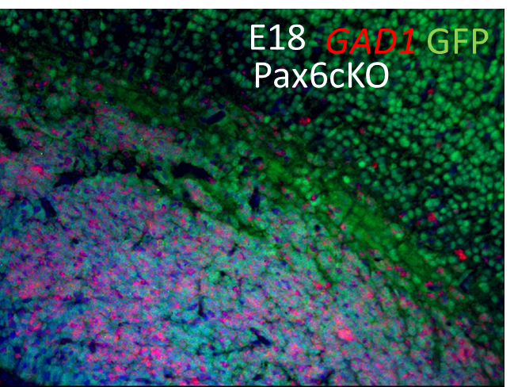
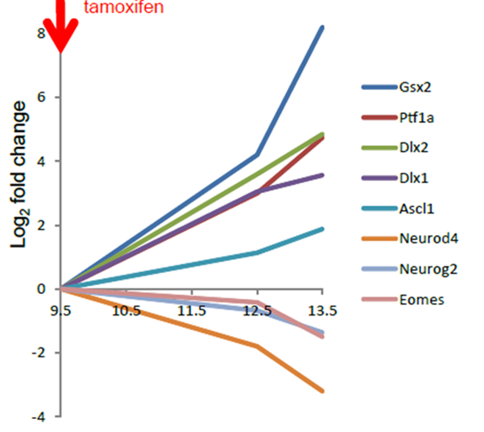
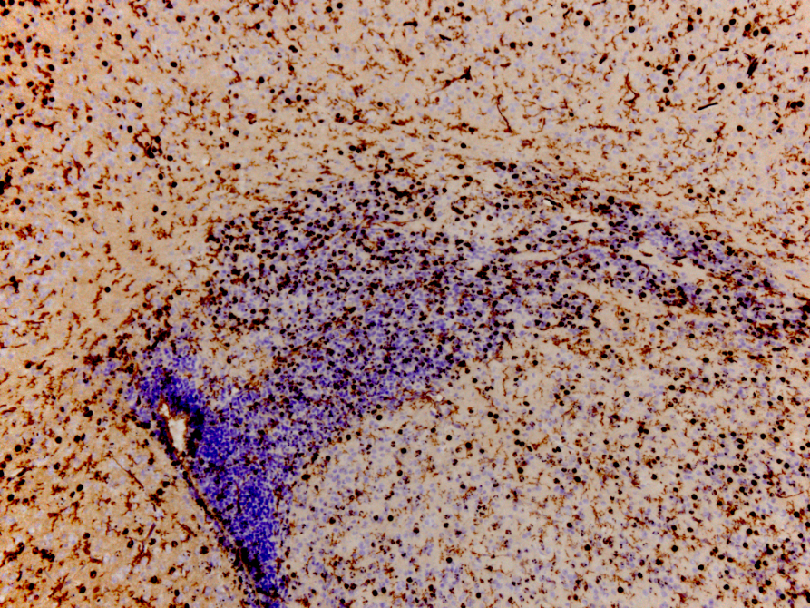
Paired-box 6 (Pax6)
DNA RNA Protein
Cell cycle
Cell Migration
Cortical Layering
Pax6
Pax6 mutant embryos (Pax6^{loxP/loxP}) (Martine/Dave and Zrinko/Martine)
P10
BrdU injected at E16.5

Slide 6
Pax6 Deletion – Radial Glia Interneuron Lineage?
Radial Glia (Dorsal Telencephalon) (Pax6)
Intermediate Progenitors (Trb2) expression
Neurogenesis
GABAergic Population?
Neurogenesis
Principals Cells
Glutamatergic Population

Slide 7
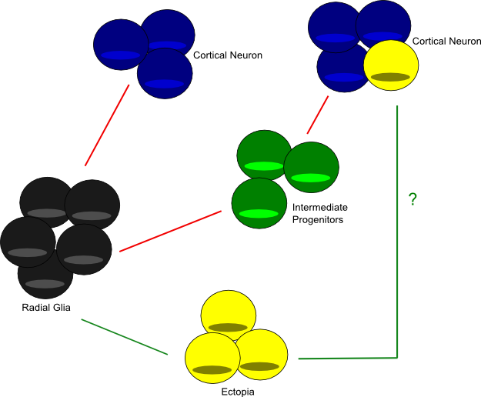
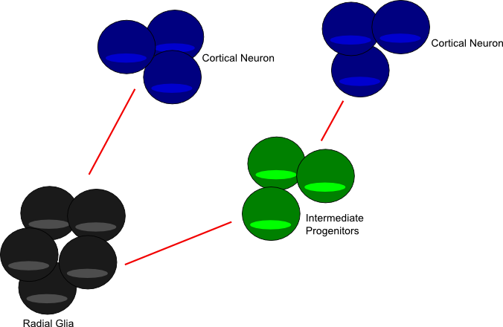
Wild-type
Pax6(-/-)

Slide 8
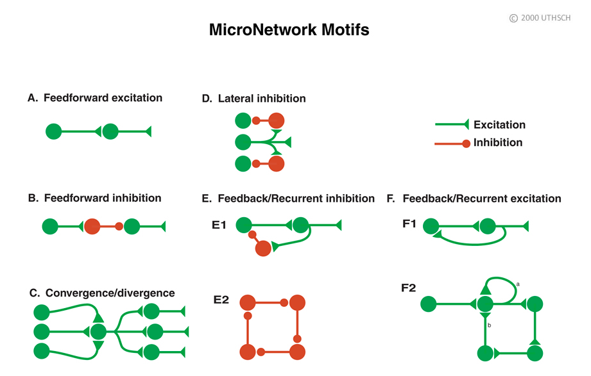
Cortical Microcircuits

Slide 9

LoxP-Cre Recombinase Genetic Manipulation I
loxP
loxP
Pax6
loxP
loxP
STOP
EGFP

Slide 10
#NOT ALL PROGENITORS

Slide 11




LoxP-Cre Recombinase Genetic Manipulation II
Temporal-Spatial Pax6 KO
Emx1-CreER^{T2}
Hsp90
Hsp90
Cre-ER^{T2}
Cre-ER^{T2}
Cre-ER^{T2}
Cre-ER^{T2}
[Cytoplasm]
[Nucleus]
E9.5
Tamoxifen

Slide 12
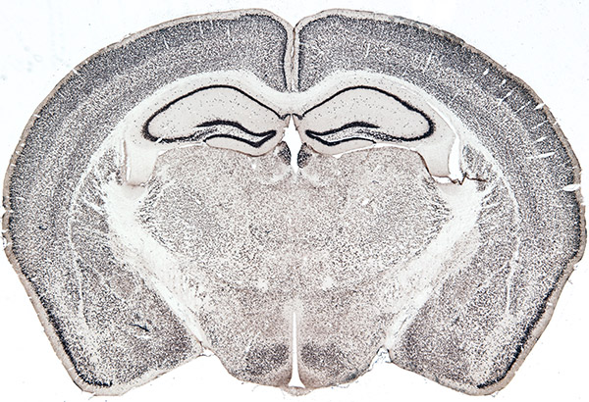
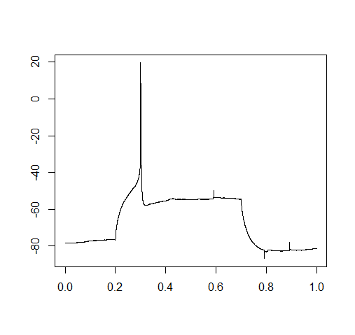
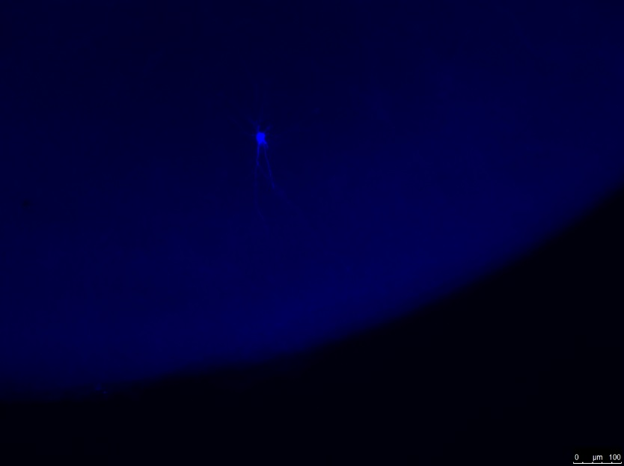
Experimental Design
Whole-cell current clamp
Ectopia (Data Stream 1)
Pyramidal Cortical Cells (Data Stream 2)
Mouse Coronal Slices (P3-P10)
Immunohistochemistry
Molecular markers
Morphology recovery

Slide 13
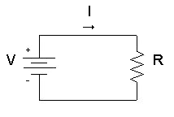
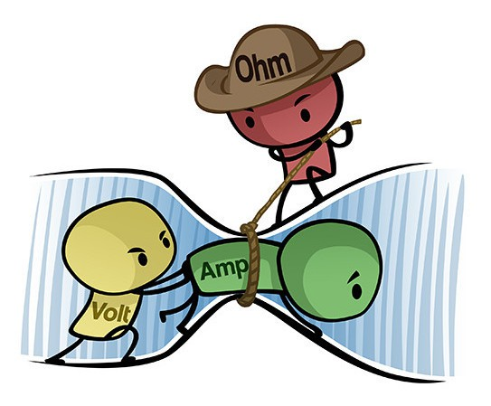
Physical Biology of the Cell I - Ohm's Law
V=I.R

Slide 14
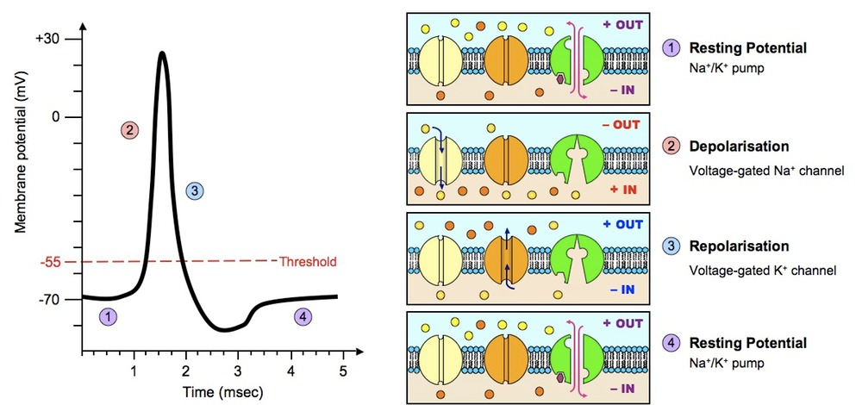
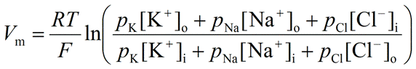
Physical Biology of the Cell II - Ions and Channels

Slide 15
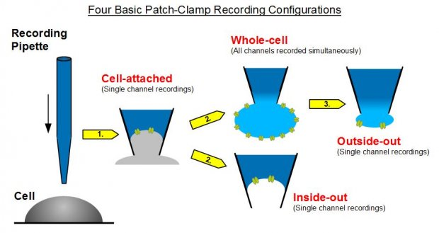
Electrophysiology I - Modes

Slide 16
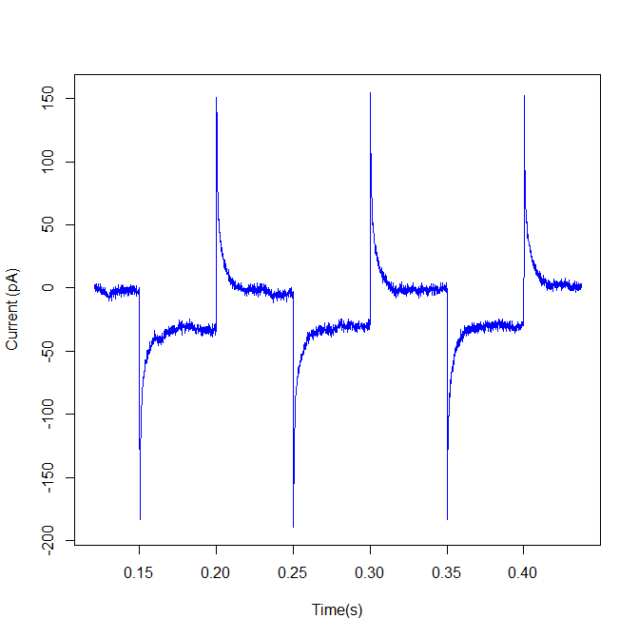
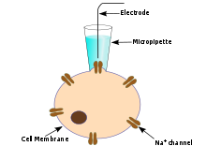
Electrophysiology II – Whole-cell

Slide 17
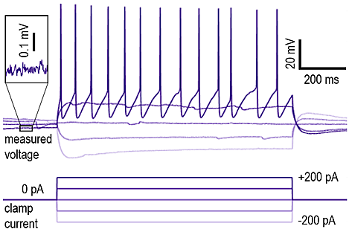
Electrophysiology III – Current Clamp

Slide 18
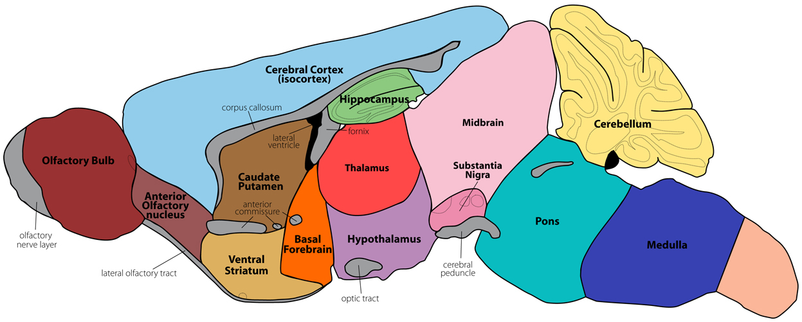
Ectopic Population I (Data Stream 1)

Slide 19
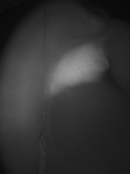
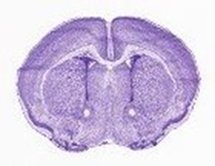
Ectopic Population II (Data Stream 1)
Pax6^{loxP/loxP}
P4

Slide 20
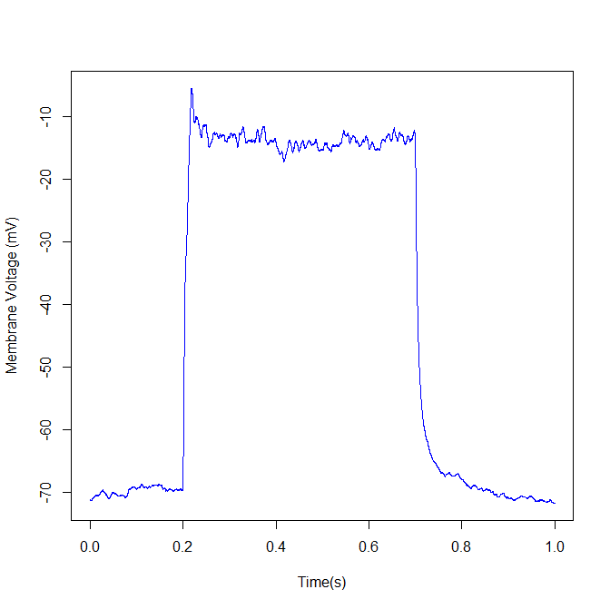
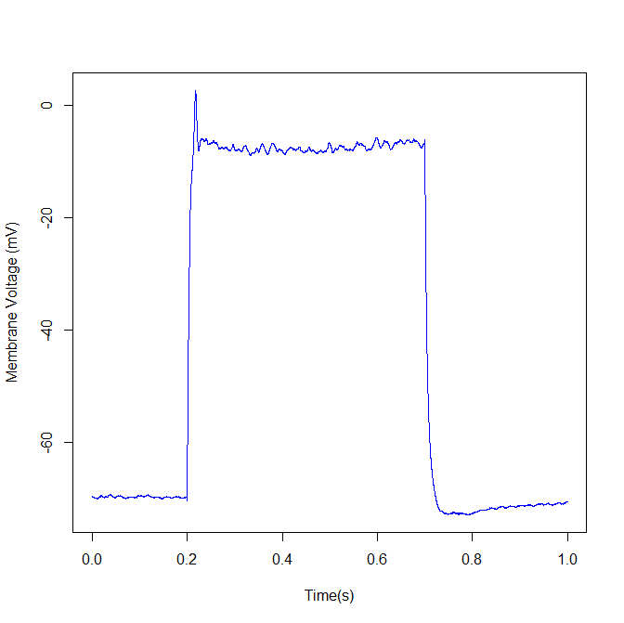
Ectopic Population III (Data Stream 1)
Pax6^{loxP/loxP}
P4
P6

Slide 21
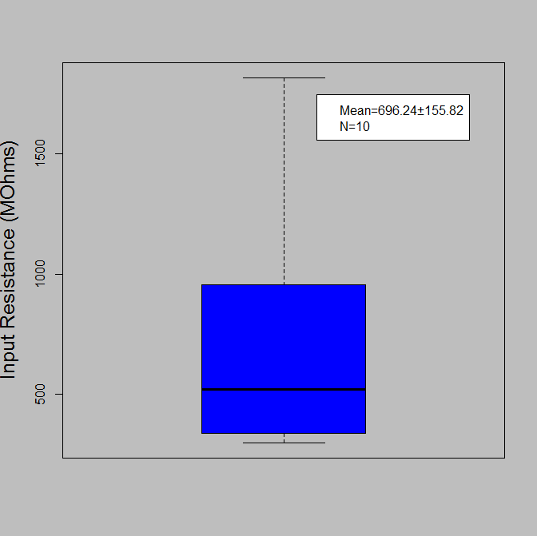
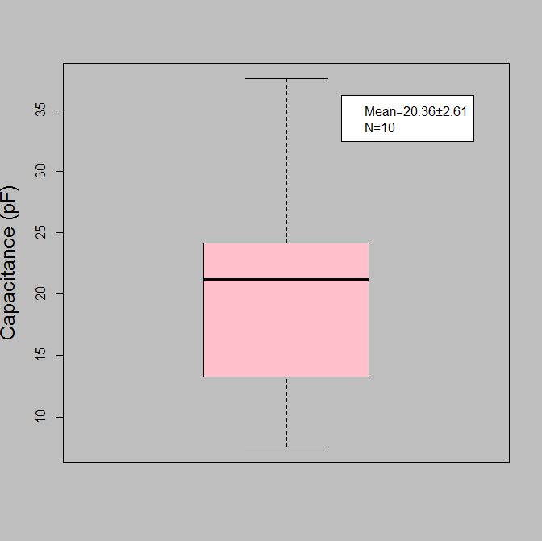
Ectopic Population V – Passive Properties (Data Stream 1)

Slide 22
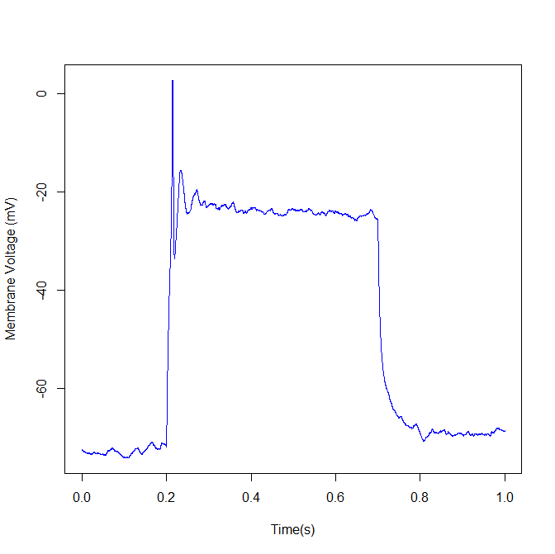
Ectopic Population IV (Data Stream 1)
Made it into the cortex???
P8

Slide 23
Pyramidal Cells of the Somatosensory Cortex I - Cortical Microcircuits
(Data Stream 2)

Slide 24
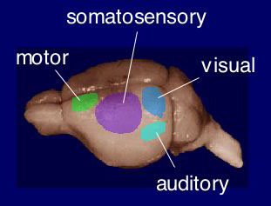
Pyramidal Cells of the Somatosensory Cortex II (Data Stream 2)

Slide 25
Pyramidal Cells of the Somatosensory Cortex III (Data Stream 2)
Sires(RP6EMX1)
Dams (FP6CD1)
Emx1-Cre; Pax6^{loxP/loxP}
Pax6^{loxP/+}
Pax6
Pax6
Pax6
Emx1
Cre-ER^{T2}
hom
Emx1-Cre; Pax6^{loxP/loxP}
hets
Emx1-Cre; Pax6^{loxP/+}
Emx1
Cre-ER^{T2}
Emx1
Pax6
Cre-ER^{T2}
Pax6
Pax6

Slide 26
Pyramidal Cells of the Somatosensory Cortex IV (Data Stream 2)

Slide 27
Pyramidal Cells of the Somatosensory Cortex V (Data Stream 2)
Layer V, Somatosensory Crtx

Slide 28
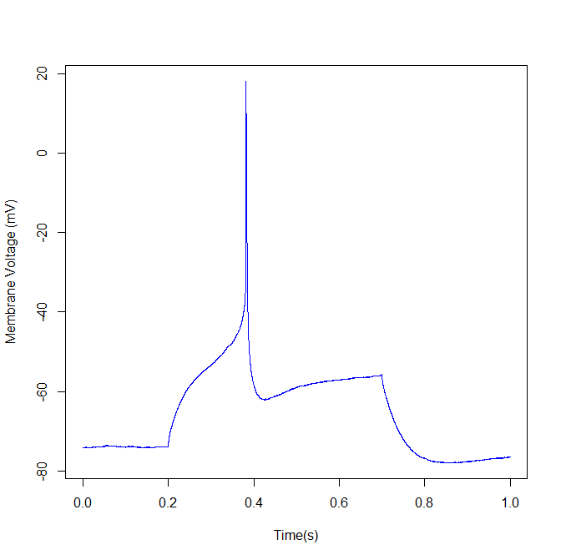
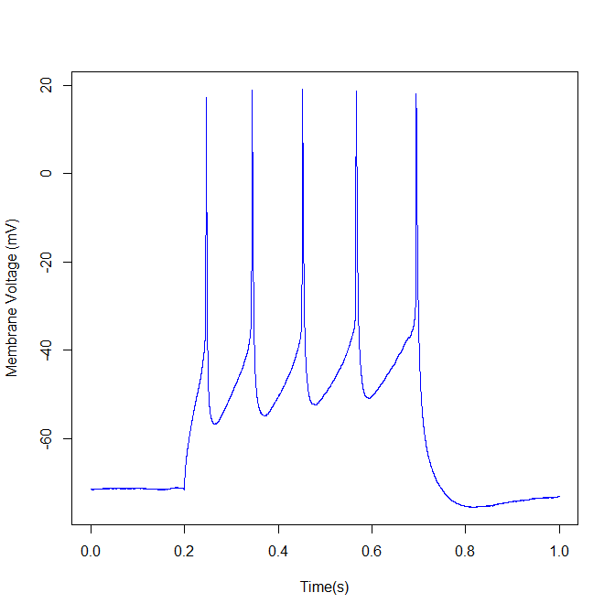
Pyramidal Cells of the Somatosensory Cortex VI (Data Stream 2)
P6 Pax6 ^{loxP/+}
80pA
160pA

Slide 29
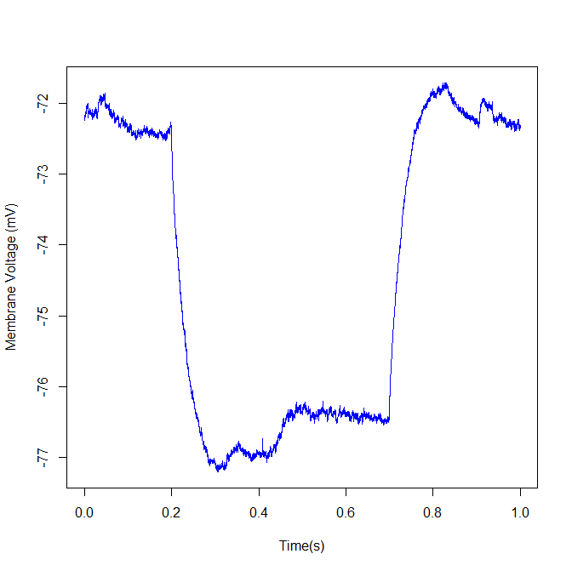
Pyramidal Cells of the Somatosensory Cortex VII (Data Stream 2)
P6 Pax6 ^{loxP/+}

Slide 30
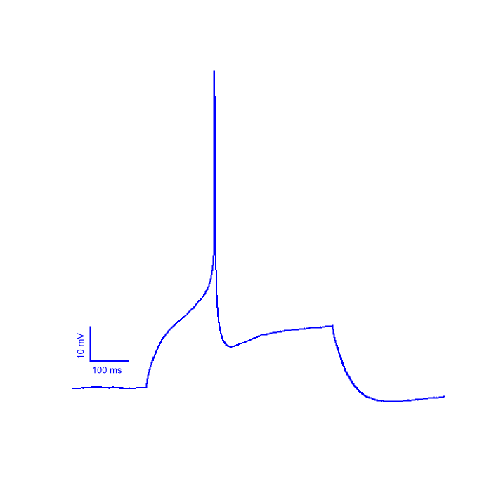
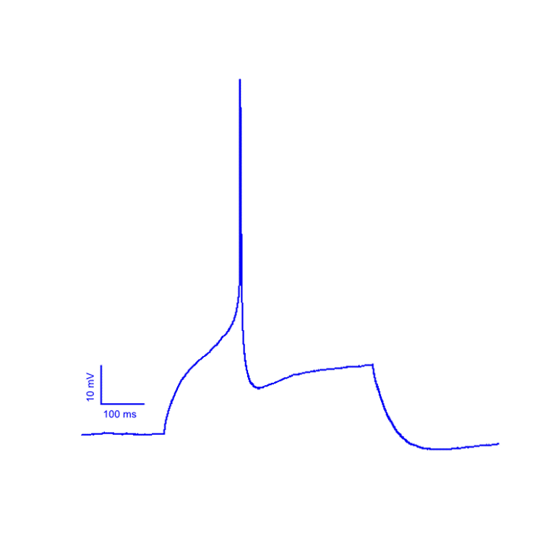

Slide 31
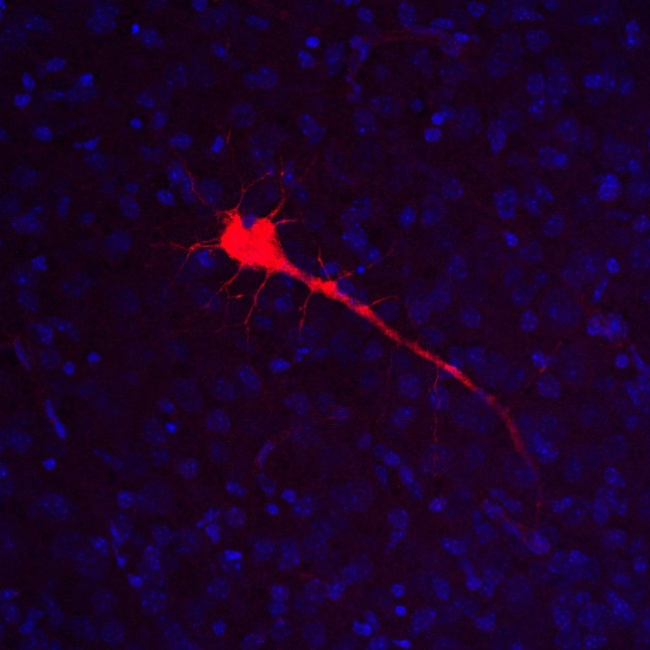
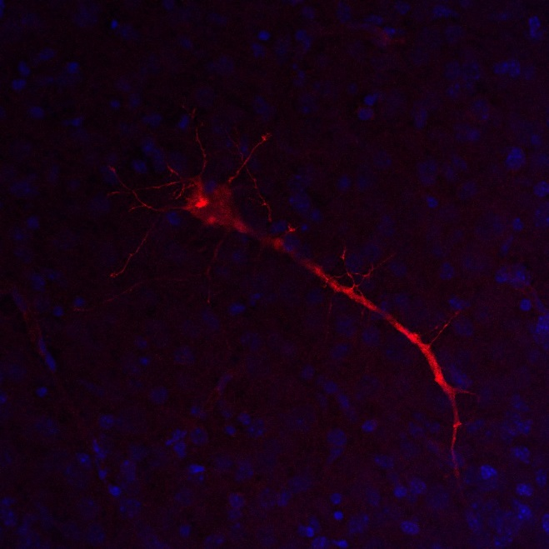
Pyramidal Cells of the Somatosensory Cortex VIII (Data Stream 2)
Lower
Upper
x40
x40
Pax6^{loxP/loxP}
Pax6^{loxP/loxP}

Slide 32
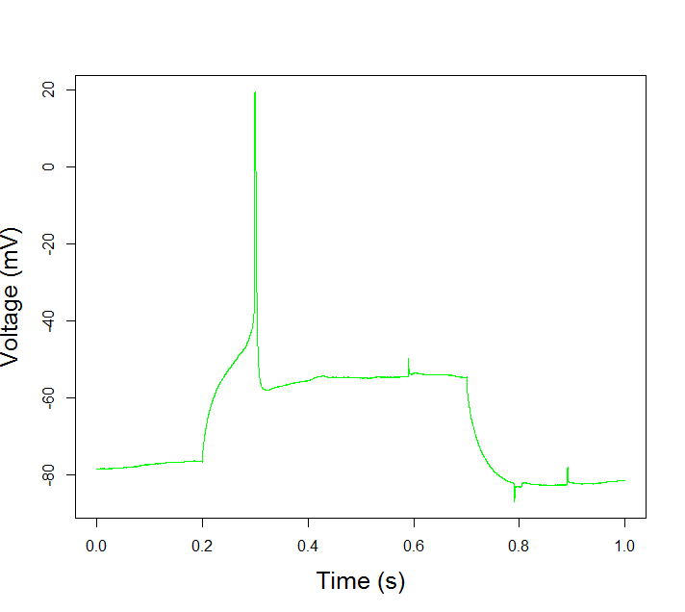
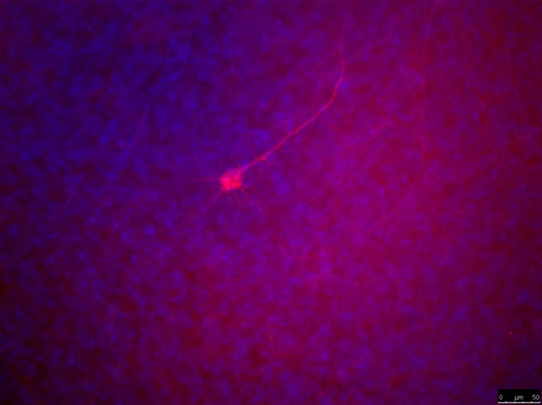
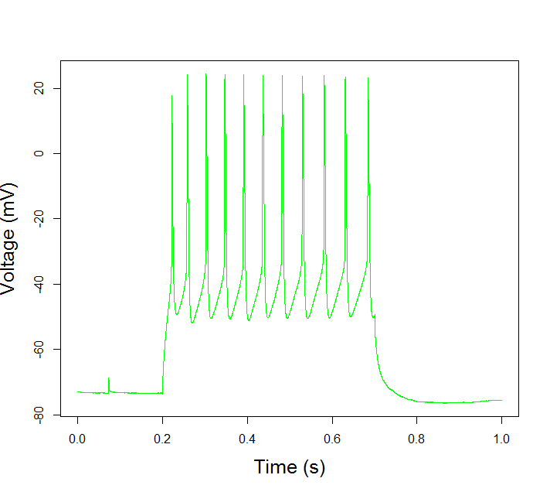
Pyramidal Cells of the Somatosensory Cortex IX (Data Stream 2)
P6 Cre-Pax6^{loxP/loxP}
x40
120pA
x20
240pA
x40

Slide 33
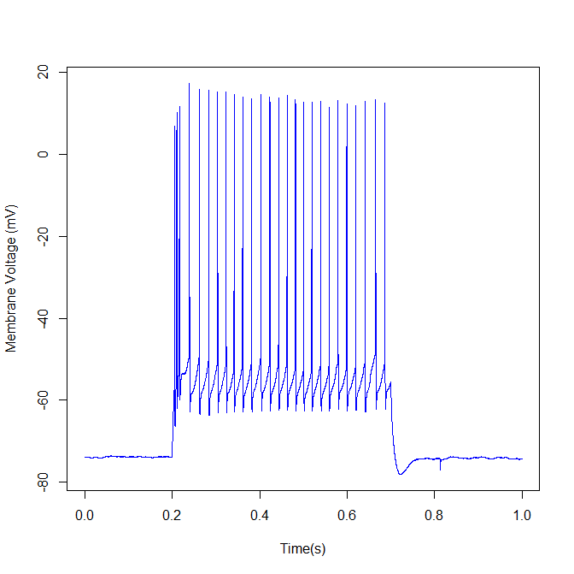
Pyramidal Cells of the Somatosensory Cortex X (Data Stream 2)
Interneurons – Different firing/morphology

Slide 34
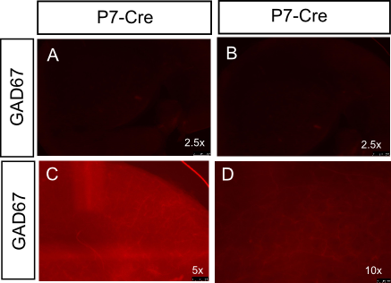
Immunohistochemistry I – Thick Slice Wall of Failure
P7 Pax6 ^{loxP/loxP}

Slide 35
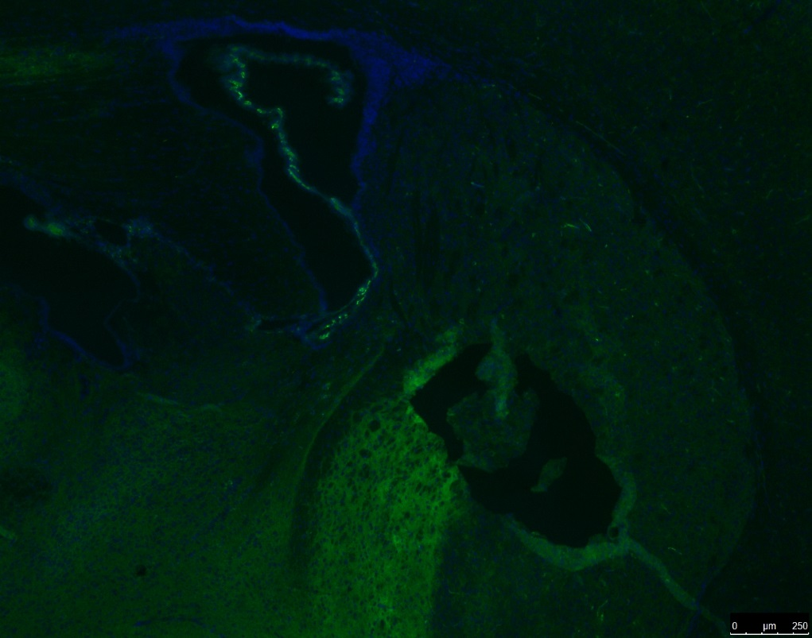
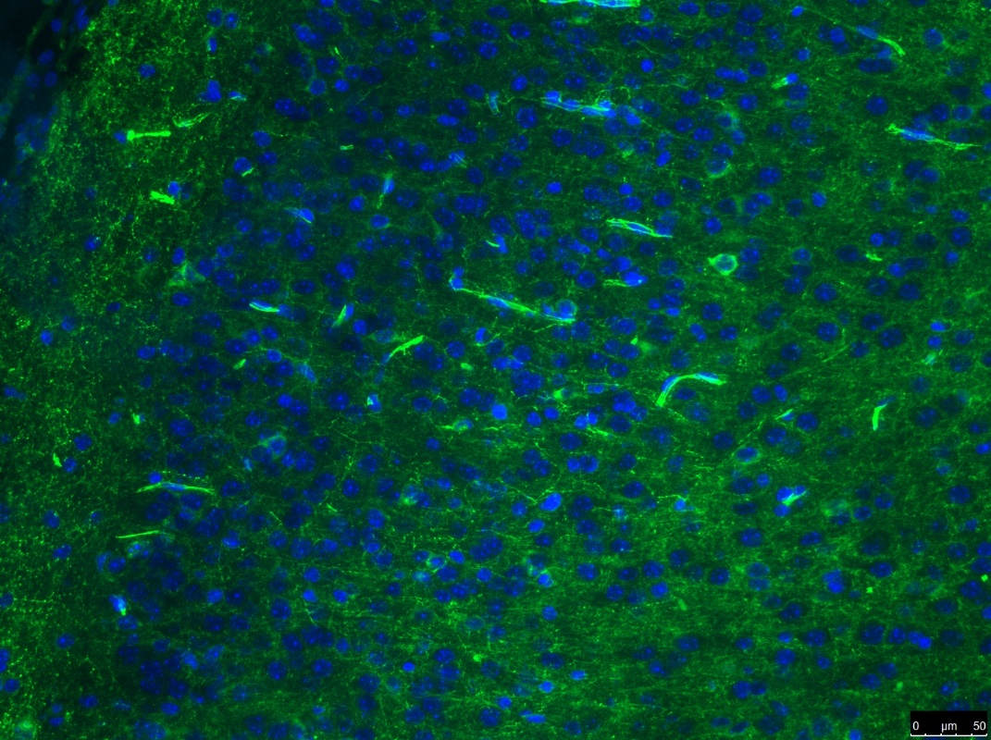
Immunohistochemistry II– Thin Slice
10 uM Coronal P10 – GAD67
10 uM Coronal P10 – GAD67
x5
x20

Slide 36
Future Directions
Immediate – 3 Months
Complete Pilot Datasets
Year 2 and 3
Pharmacology and molecular markers
Long term possibilities
Organoids
Computational Models
Primary cell culture
NMDA Receptors
Cortical layering
New genetic manipulation
Synaptosomes

Slide 37
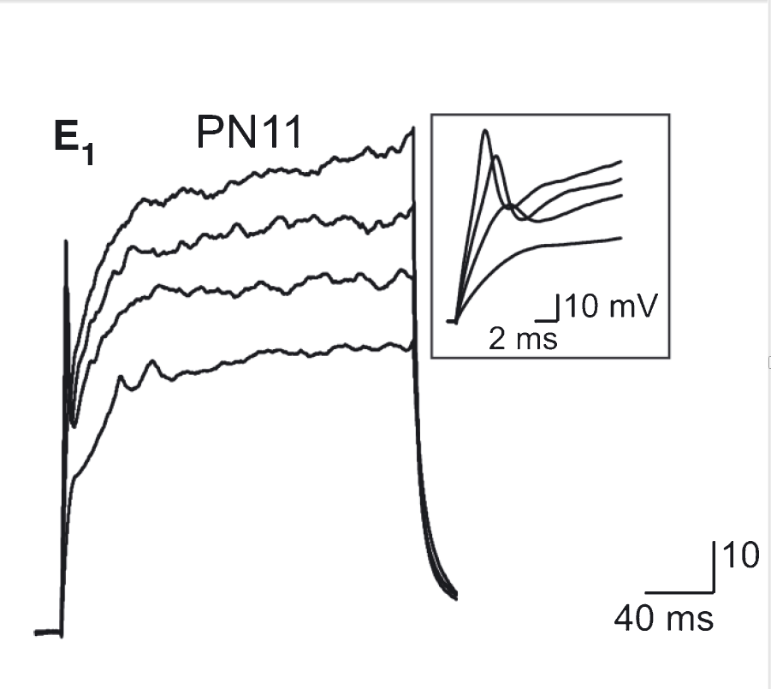
Multiform Future – Ectopia Cell Culture
Oligodendrocyte Precursor Cells (OPCs)
Maldonado et al., 2013

Slide 38
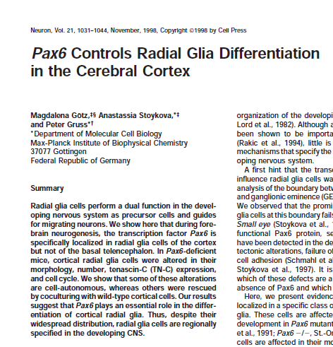
Multiform Future – Ectopia Cell Culture
Ephys in Primary Cell Cultures
Gotz et al., 1998

Slide 39
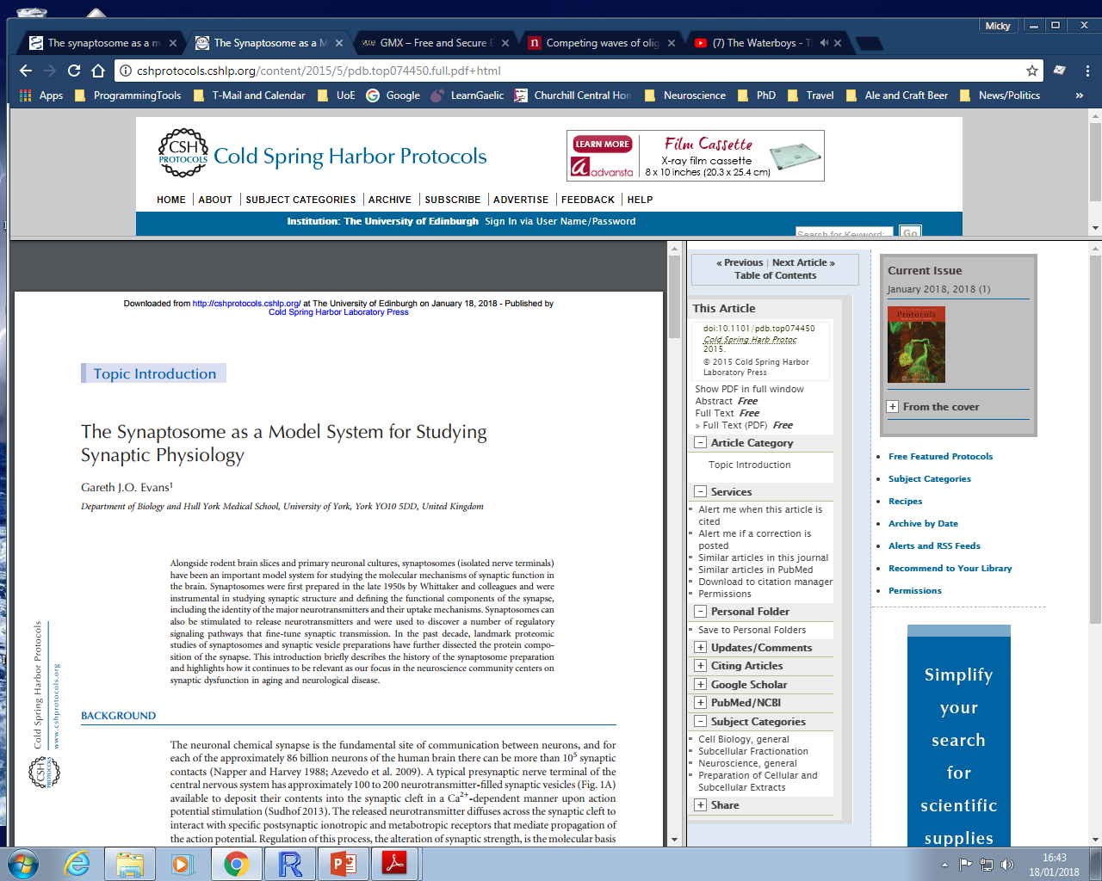
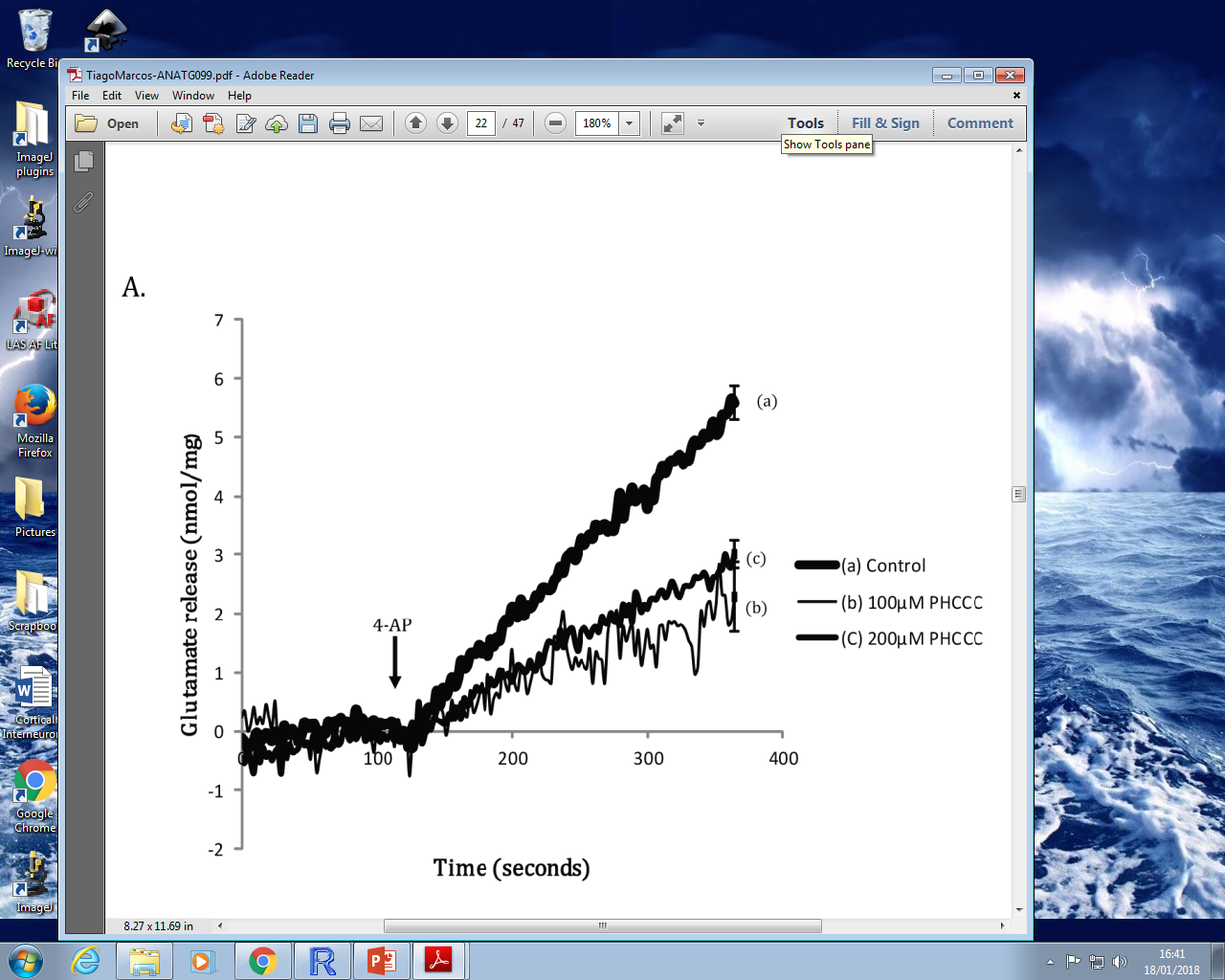
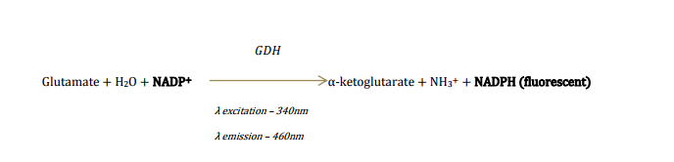
Multiform Future – Ectopia Cell Culture
Synaptosomes
Evans, 2015

Slide 40
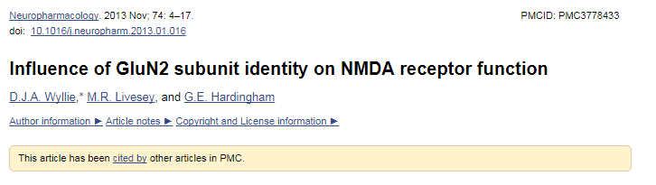
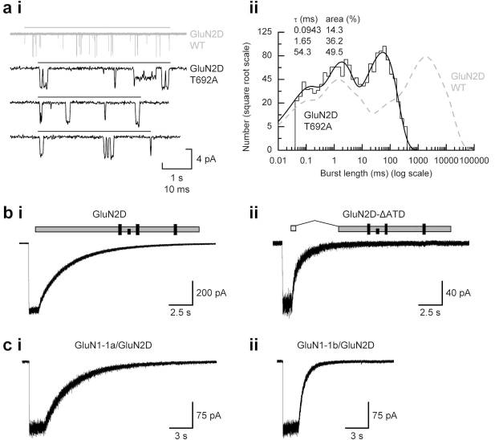
Multiform Future – NMDA
GluN2A/B Switch
Wyllie et al., 2013

Slide 41

Acknowledgments
Dr Michael Daw
Prof. Dave Price
Dr Martine Manuel
Dr Melanie Stefan
Dr Soham Mitra
Dr Sean McKay
Mike Molinek
Dr Adam Jackson
Laura Oliveira
Rita Loureiro
Sarah Tennant
Jonny Marshall
Zrinko
Kai

